Slide 1
Mummichog analysis at the command line
Stephen Barnes, PhD
With many thanks to Shuzhao Li, PhD (Emory University)
Li S, Park Y, Duraisingham S, Strobel FH, Khan N, Soltow QA, Jones DP, Pulendran B. Predicting network activity from high throughput metabolomics. PLoS Comput Biol. 2013;9(7):e1003123.
Uppal K, Walker DI, Liu K, Li S, Go YM, Jones DP. Computational Metabolomics: A Framework for the Million Metabolome. Chem Res Toxicol. 2016 Dec 19;29(12):1956-1975.

Slide 2
Software for mummichog
Go to https://docs.anaconda.com/anaconda/install/
You need version 2.7

Slide 3

Should take 1-2 min. Follow the commands.

Slide 4
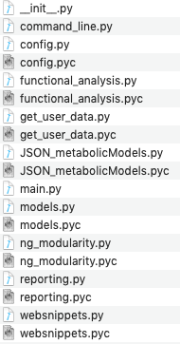

The URL for mummichog is https://pypi.org/project/mummichog/
Download the mummichog 2.0.6.tar.gz option. Unzipping it will create a mummichog-2.0.6 folder. I put this in my Applications folder (on my Mac).
Inside the mummichog-2.0.6 folder are the following:
This is the script that’s invoked

Slide 5
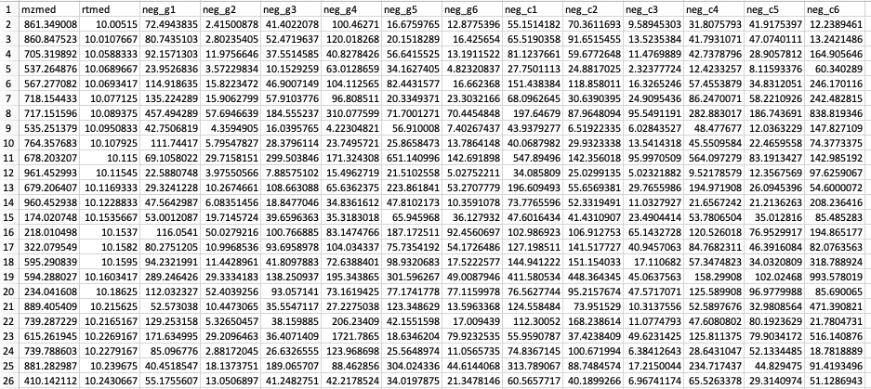
This is the Excel file that we used to make the .csv files
Now sum all the ion peak areas and normalize to the G1 sample. This involves calculating the multiplication factor for each other sample (G2-G6 and C1-C6).

Slide 6
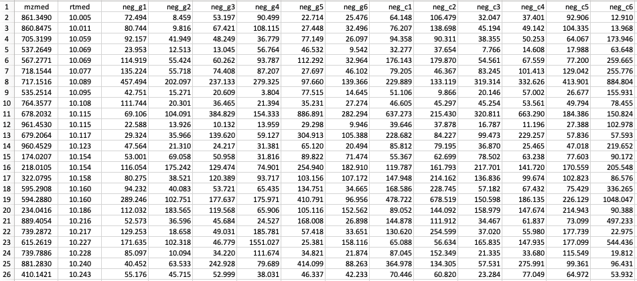
Normalized files

Slide 7
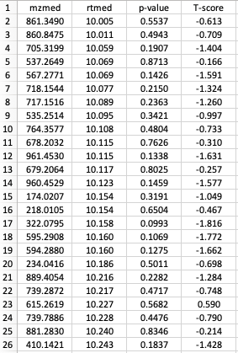
To prepare for mummichog analysis, a .txt file is created in Excel containing the m/z value, the retention time, the p-value between the con (C1-C6) and gen (G1-G6) groups and the corresponding T-score.
Note the values in the columns should be numbers and not algebraic functions used to calculate the p-values and T-scores.
The .txt file should be placed inside the folder where mummichog-2.0.6 is located. On my computer it’s in a folder called test. You need to remember the path to the file.

Slide 8
To run mummichog, now open the Terminal file in Utilities (on a Mac) to go to the command line. Use the change directory command to go to the main Applications folder
cd /Applications
Now change the directory again to go to the mummichog-2.0.6 folder
cd mummichog-2.0.6
Use the list command (ls) to check the content of this directory
PKG-INFO
README.rst
mummichog
mummichog.egg-info
setup.cfg
setup.py
test

Slide 9
The command line to invoke mummichog analysis of the saved .txt file is as follows:
mummichog/main.py -c 0.02 -f test/MCBIOS_neg.txt -m negative -p 100 -o MCBIOS_neg_out
The parameters for the analysis are as follows:
-c the statistical cutoff (set at p <0.02)
-f the path to the file to be analyzed including its name and extension
-m the ionization type (the default is positive)
-p the number of permutations whereby an equal number of non-significant ions are mapped to known pathways
-o the name of the output folder

Slide 10
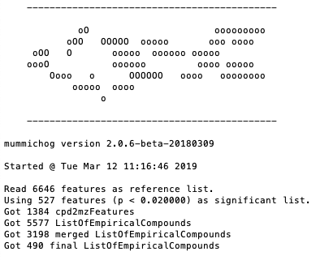

Slide 11
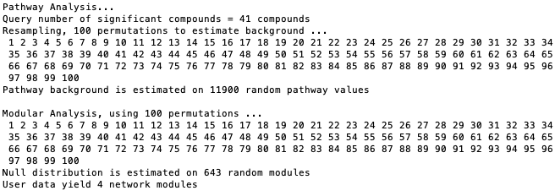
Go back to the mummichog-2.0.6 folder to get the results

Slide 12
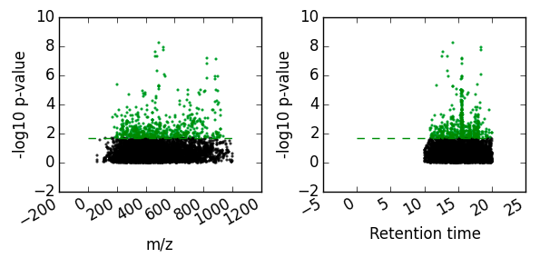
There were 41 significant metabolites. To run mummichog, 41 non-significant metabolites were randomly selected from all the non-significant metabolites 100 times and mapped to known pathways to estimate background. Then the 41 significant metabolites were also mapped to these pathways and a Fisher Exact test applied to determine those pathways that most significantly involved.
Manhattan plot of the -log₁₀ p-values versus m/z and retention times.

Slide 13
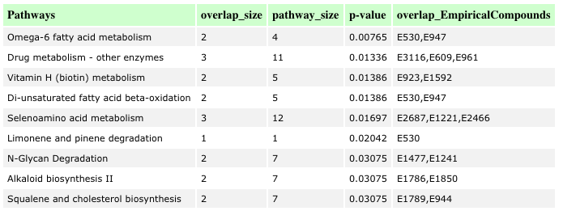
Pathways that have increased presence for metabolites that have p <0.02 values.

Slide 14
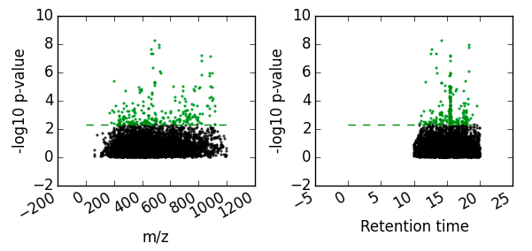
It is reasonable to apply a more rigorous p-value cutoff. So, repeat the mummichog analysis with the p-value cutoff set to 0.005. Note that in the command line mode, you can recreate the command you previously typed in by pressing the up arrow key. Now use the left arrow to scroll back up through the command to the -p 0.02 statement – change the “0.02” to “0.005” and then use the right arrow to go to the end of the command statement. Pressing return will re-run mummichog.

Slide 15
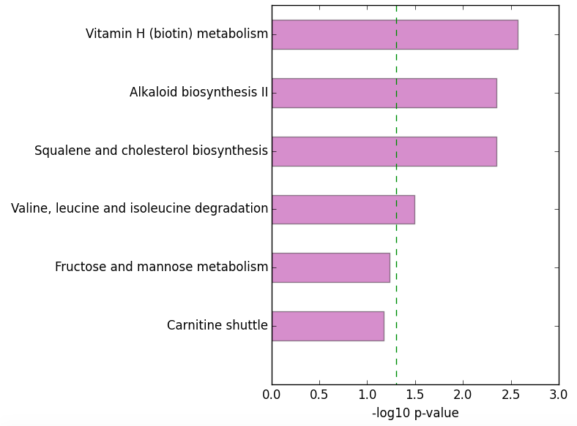
Pathways now selecting for those with p-values <0.005

Slide 16
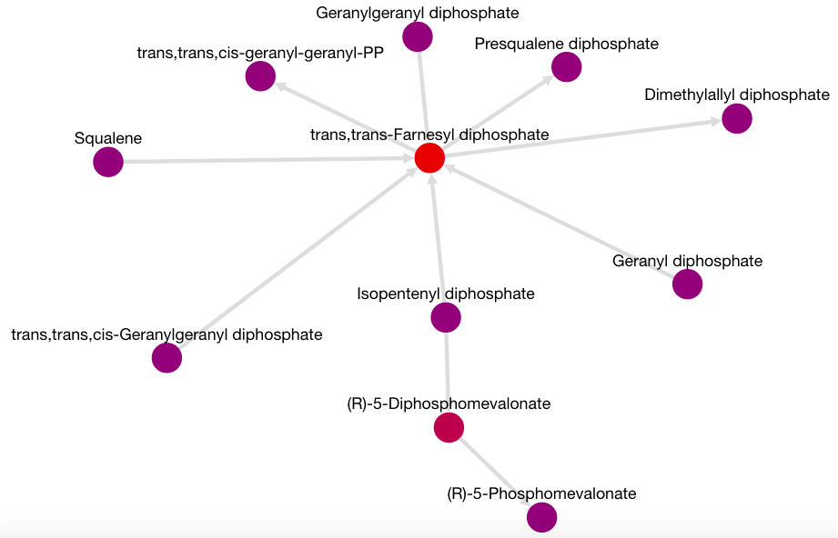
The number of putative metabolites falls from 41 to 15 with this tighter restriction of the p-values. In doing so, the pathways that are considered to be significant change, with the squalene and cholesterol synthesis pathway becoming more prominent. The activity network also shows that it is based on isoprene phosphate intermediates
Note that this analysis should not be considered as proof of the importance of a pathway. Separate experiments with a more focused examination of the putative metabolites is required.

Slide 17
Questions?

